Slide 1


Smart home project

Slide 2
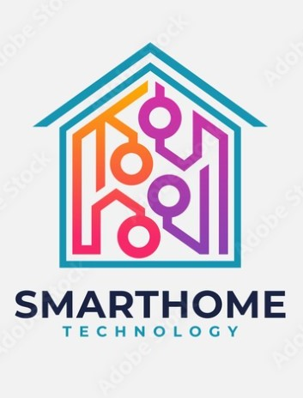
Table of Contents
1- Chapter 1 :(intro)
Introduction to Technological development in our lives and the emergence of artificial intelligence…………….. (3).
What is a smart home and smart home information……………(3-4).
2- Chapter 2:
Project implementation steps………..(5-6).
3- chapter 3:
project equipment………..(6).
Picture of the tools used to build the house……………….(7).
picture of equipment and explained tools ………………..(8-21).
4- chapter 4:
Pictures of the project codes……….(22).
pictures during meetings with the project completion team, whether through the college directly or online……(23).
A picture while storing solar energy from panels and converting it into electrical energy……….(24).
The final image of the project form after implementation ………..(25).
the image of the implementing team and their names…….(26-27).

Slide 3

INTRODUCTION
The last years of the twentieth century witnessed great developments in computer systems, technology, and information systems in what was commonly known as the digital revolution.
Smart homes are buildings you can think of! This means that you know exactly what is going on inside and out. She can decide! By taking the best solutions to determine the appropriate environment for the users. They are the buildings of the future. Homes using the latest technology and the latest technology to manage all the elements of the house or building using the computer. It responds to the wishes of users, achieving the greatest flexibility, convenience and security. Which means less human use. Where the computer controls the affairs of electricity, heating, lighting, air conditioning, fire and alarm systems, audio-visual systems, and various electronic devices and others that it enters into the design of the building. in a way that integrates with the environment.

Slide 4
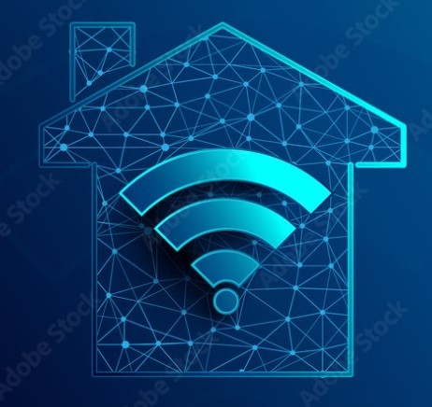
What is a smart home?
An integrated system that allows the user to control vital functions in the home, such as:
Electricity consumption and lighting control.
Electric gates for doors in the house.
Take advantage of solar energy to store it in solar panels and convert it into electrical energy when needed at home.
home communication systems and other examples……

Slide 5
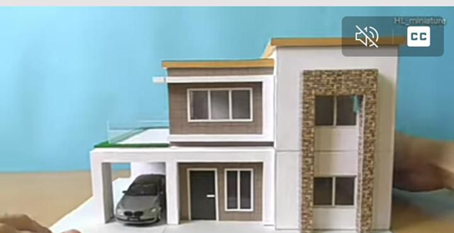

Project implementation steps:
We have had meetings with members of the project team. Through this, we conducted a feasibility study for the project in terms of the tools, measurements and dimensions of the house.
Requirements have been defined and the appropriate equipment and tools needed for the project have been purchased.
Using some ideas to create a model of the house, the following model of the house was chosen.

Slide 6
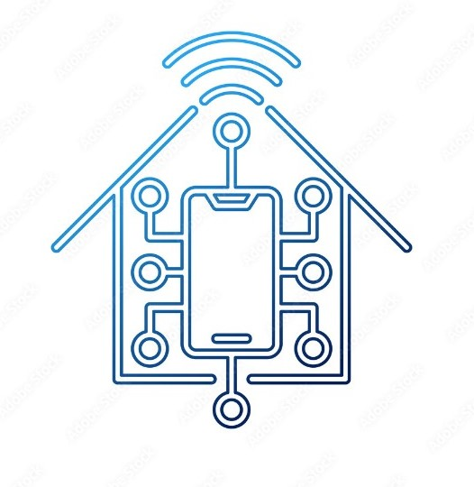
Study devices in terms of how they work, how they are installed, and how to code each device.
We wrote the codes for the project.
Meeting :While working on the project, we held meetings to find out the progress that was reached through the assembly at the university or through the online.
Parts of the house were built and appliances installed.
We charge solar panels in order to benefit from clean energy.
We tested the project and made sure it was working properly.

Slide 7

Used equipments :
Arduino-board-UNO.
ESP8266 ESP-12E NodeMcu LUA .
Servo motor micro (180).
Ultrasonic sensor SR04.
PHcr-20cm.
Relay 1 port.
12 to 6 volt downstream transformer.
charging regulator.
Dc 101.
12 volt battery.
Two 12 volt solar panels.
pcs soldering board.
Led.
Traffic light.

Slide 8

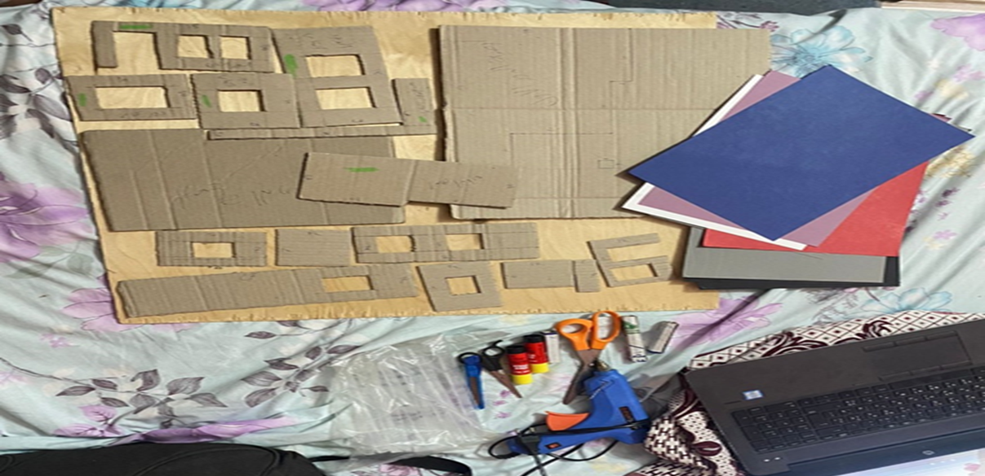
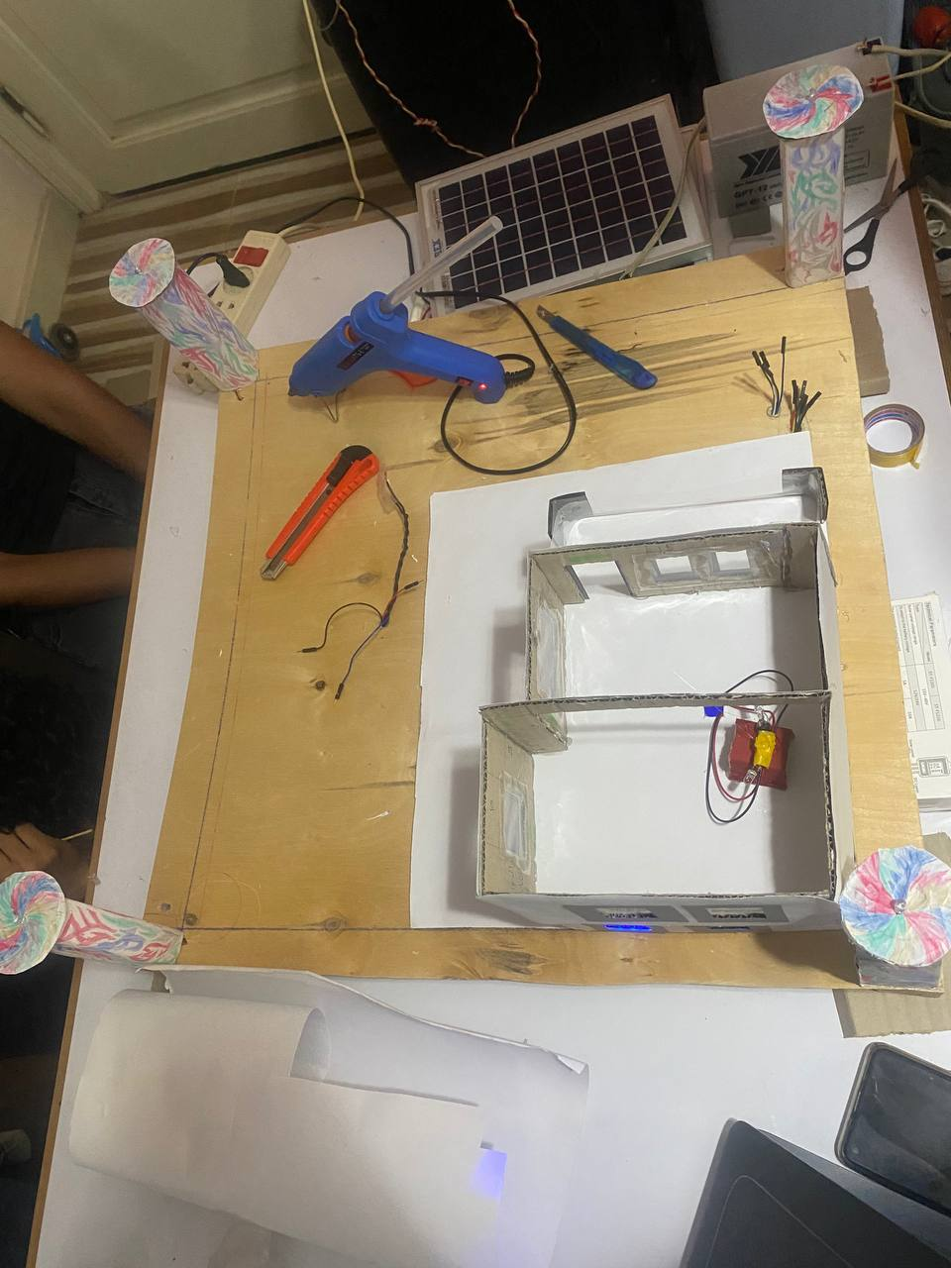
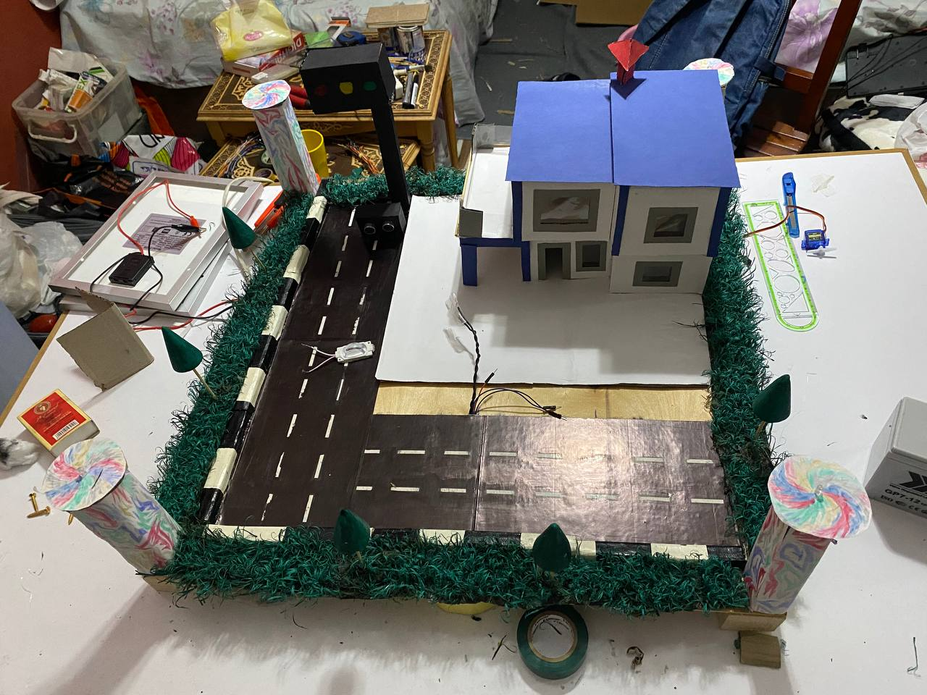
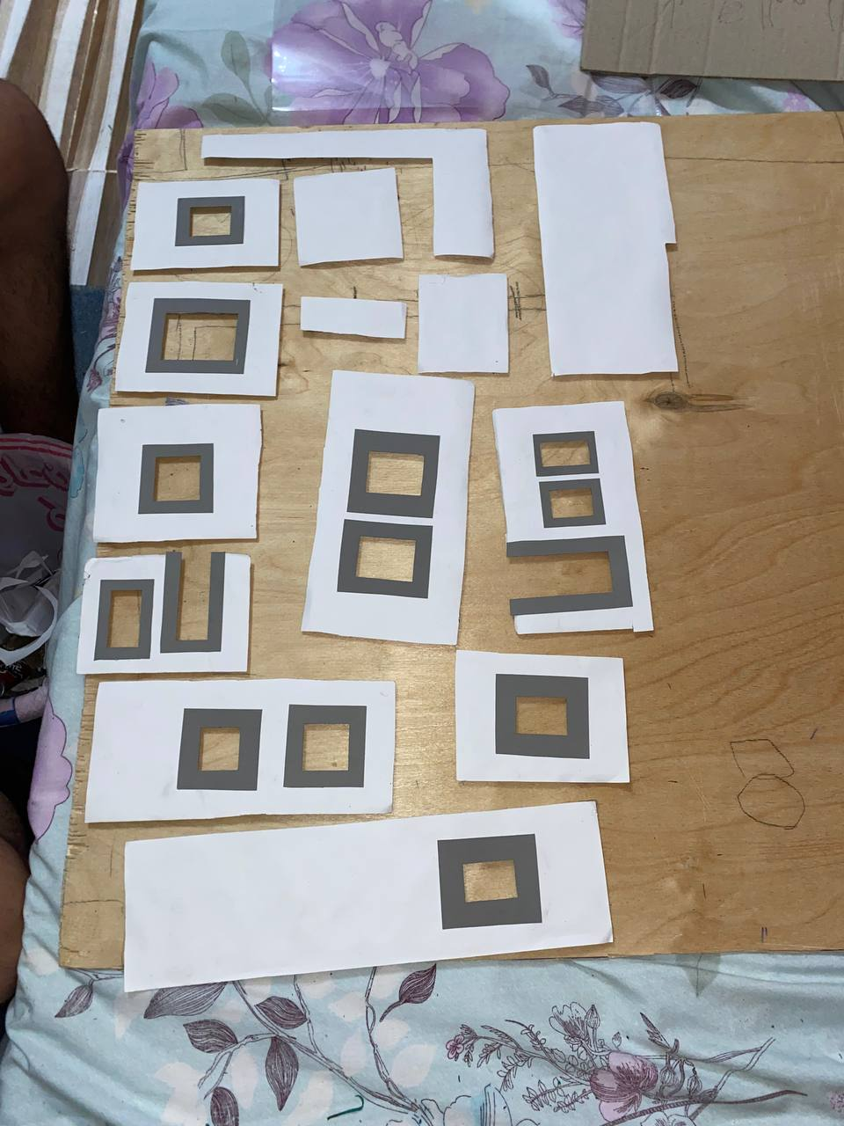
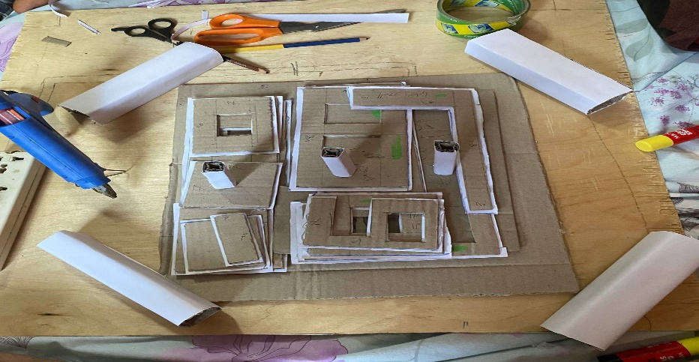
Picture of the tools used to build the house

Slide 9
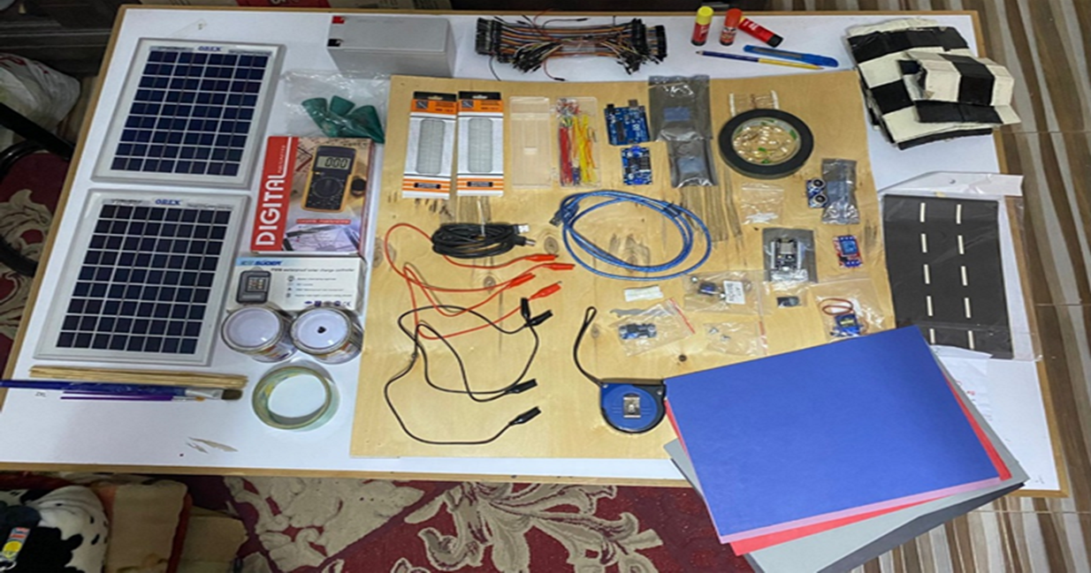
Picture of the project tools used

Slide 10
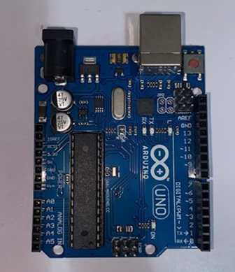
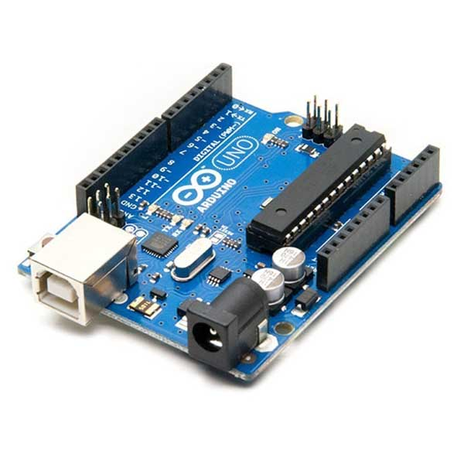
Arduino- board-uno :
Arduino is an open source platform that is used to build electronic projects. The Arduino consists of a programmable circuit board (called a microcontroller) and a programming part, an integrated development environment (IDE) running on a computer that is used to write and upload code from the computer to the Arduino board.

Slide 11
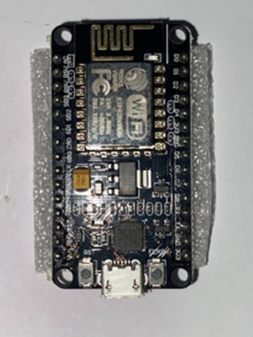
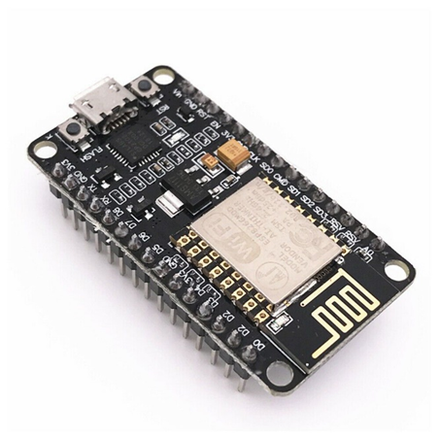
ESP8266 ESP-12E NodeMcu LUA CP2102:
It is a highly integrated chip designed for network needs and provides a self-solving Wi-Fi problem allowing it to host the application.

Slide 12
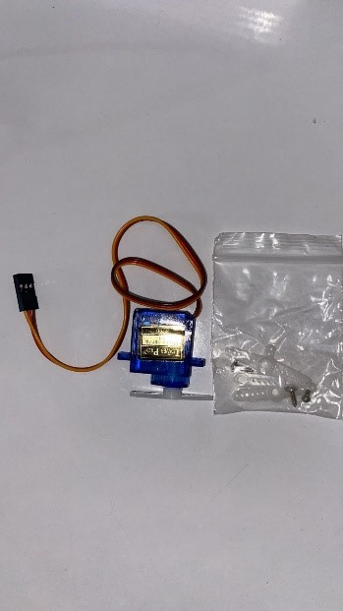
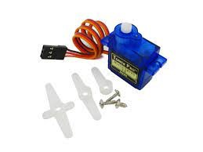
Servo motor micro (180):
A servo is a motor that can rotate at a certain angle by preprogramming it via Arduino or any electronic circuit.

Slide 13
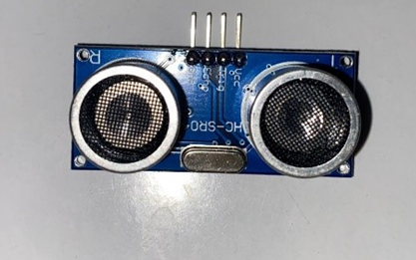
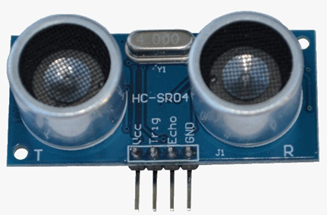
Ultrasonic sensor )SR04(:
The HC-SR04 Ultrasound Sensor is a sensor that can measure distance. It emits ultrasound at 40,000 Hz (40 kHz) which travels through the air and if there is an object or obstacle in its path it will bounce back into the unit.

Slide 14
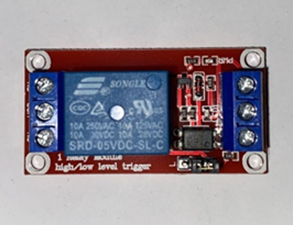
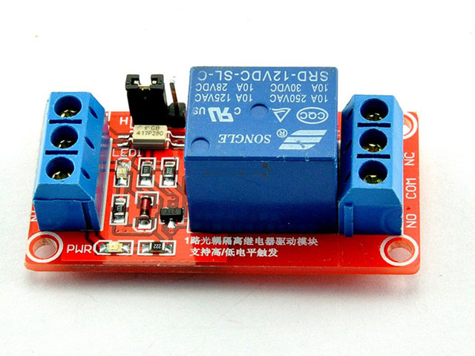
Relay 1 port :
the electrical switch :It opens and closes a circuit called the power circuit under the control of another circuit called the control circuit, and then performs the function of electrical insulation or what is known as galvanic isolation between the two circuits.

Slide 15
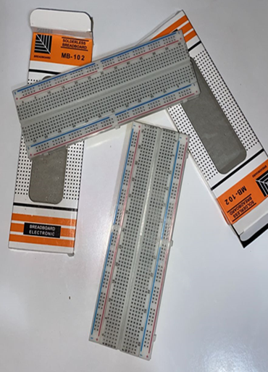
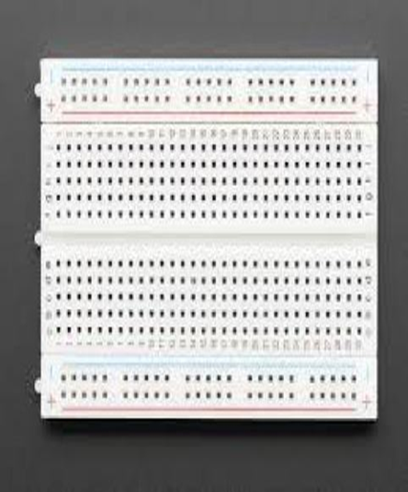
pcs soldering board :
It is a flat plate used as a base for connecting electronic components.
To build electronic circuits. and modeling of electronic devices It is seamless and reusable which makes it easy to use for creating temporary prototypes and circuit design experiments.

Slide 16
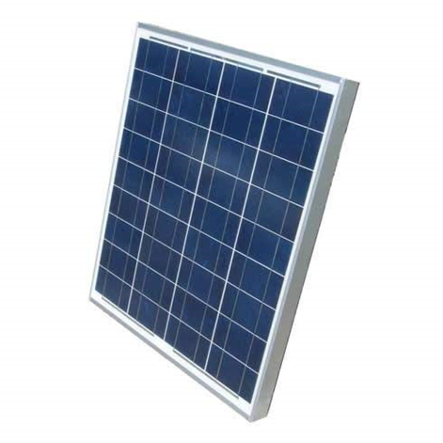
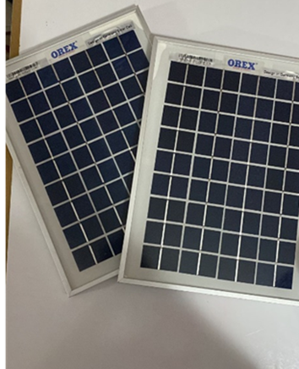
Two 12 volt solar panels :
Solar panels: They are used to absorb sunlight and convert it into electrical energy.

Slide 17
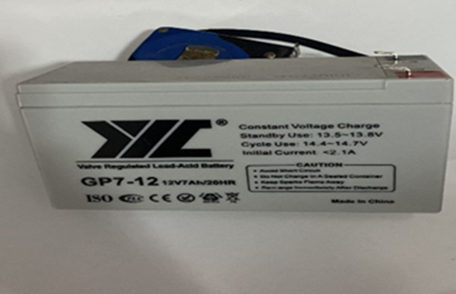
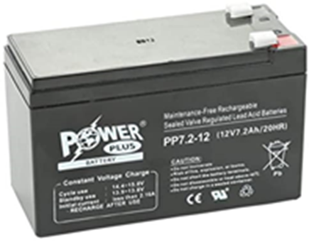
12 volt battery :
It is used to store the energy derived from solar radiation that is absorbed by the solar panels and this energy derived from the panels is used in home electricity.

Slide 18
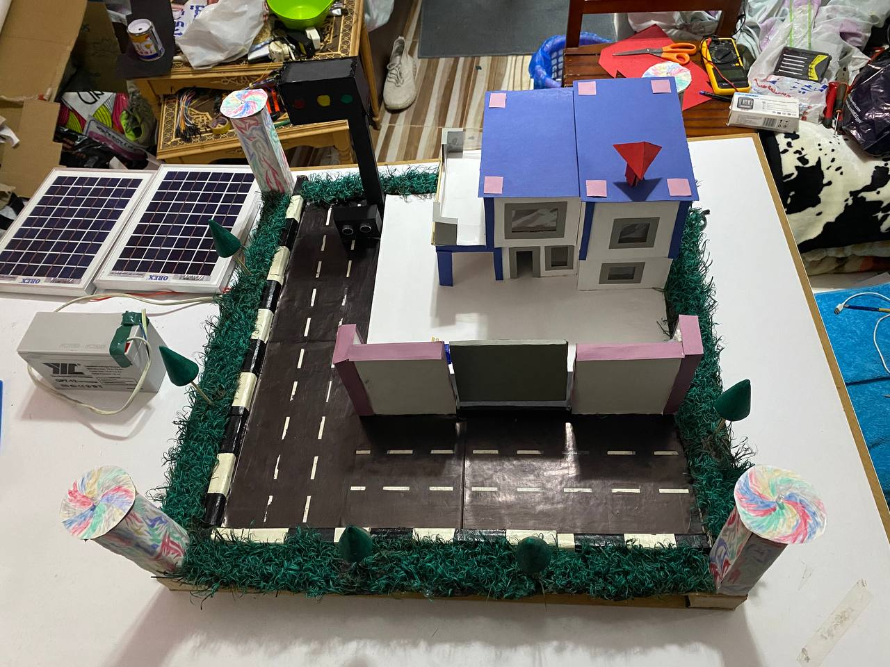
traffic light :
Traffic light: used to simulate traffic.

Slide 19
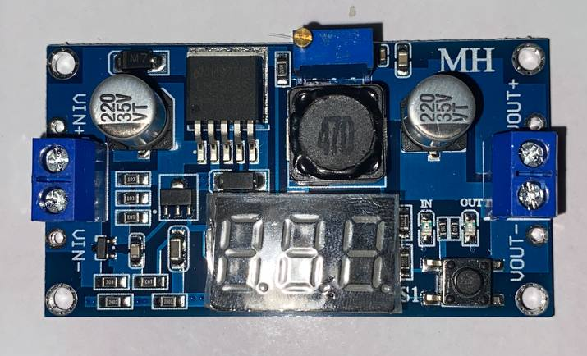
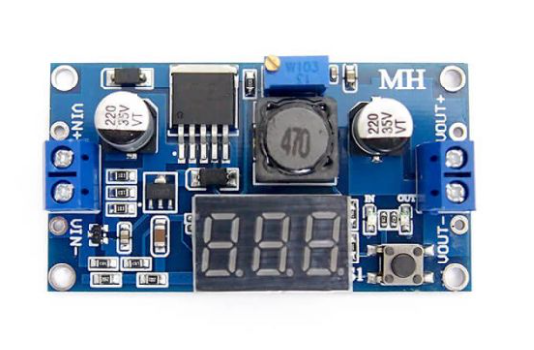
LM2596S DC-DC Adjustable Step-Down Module (3A) LED Voltmeter Module:
It is a DC transformer used to regulate the current entering the project.

Slide 20
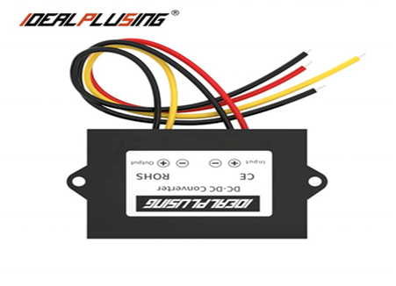
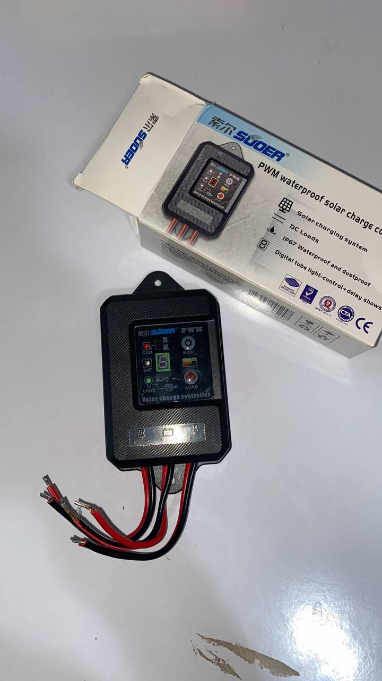
PWM water proof solar controller:
Prevent the battery from over-charging, over-discharging and reverse-discharging to the solar panel during nights.
The controller will start the lighting system in the evening automatically according to the ambient lighting.
The controller can automatically turn off the lighting system:
The light turns off automatically at dawn when the battery is full.
The light turns off automatically when the battery is low.

Slide 21
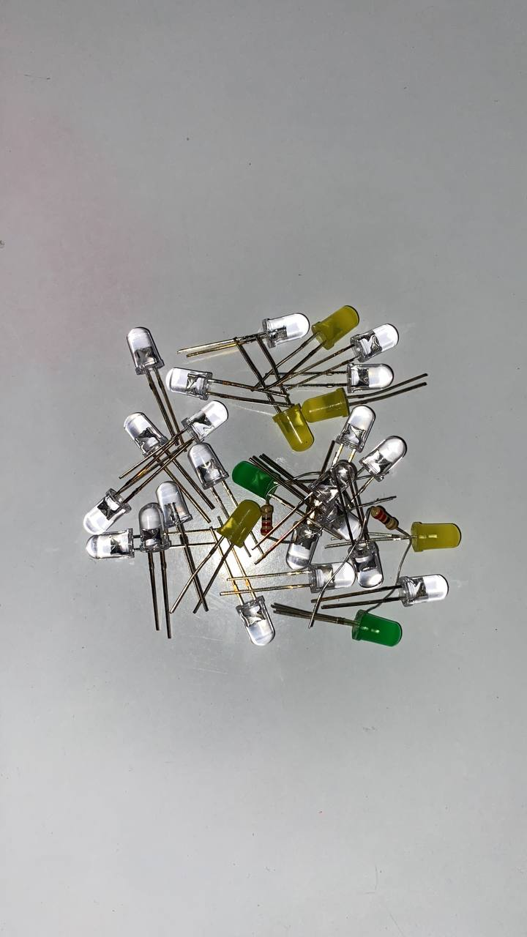
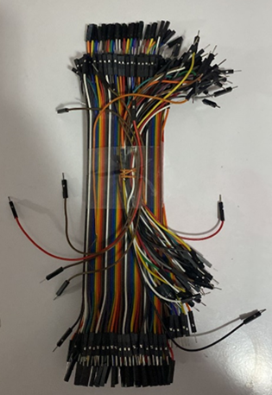
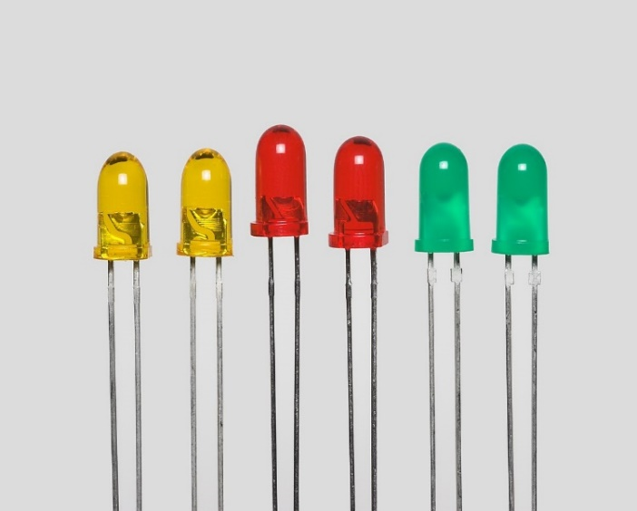
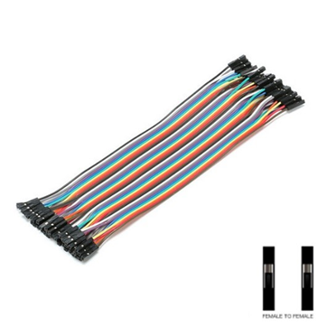
LED &PHcr-20cm:

Slide 22
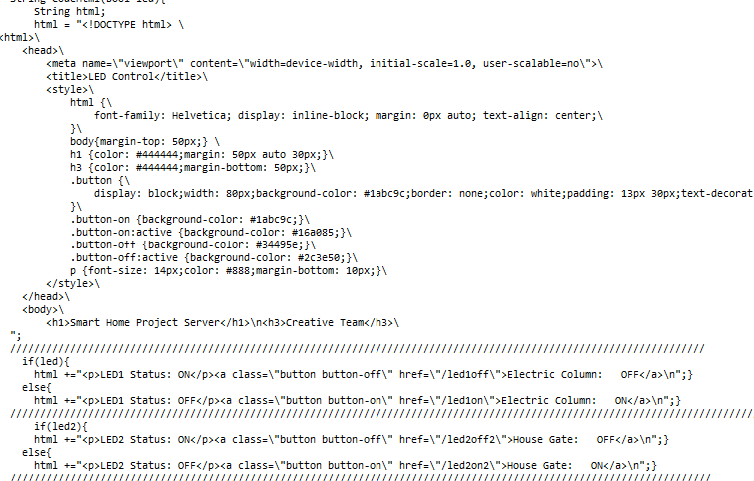
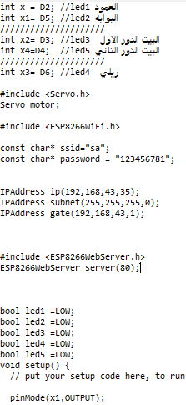
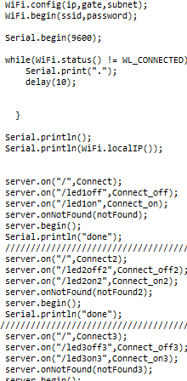
Some pictures from the project codes
Pictures of part of the project code:
Part of the user interface code:

Slide 23
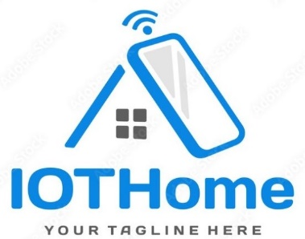
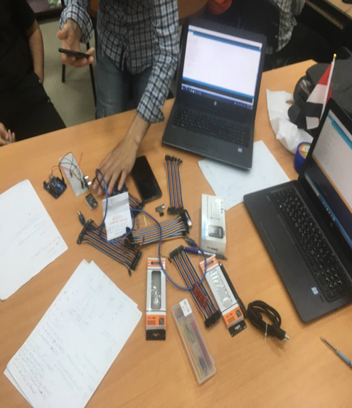
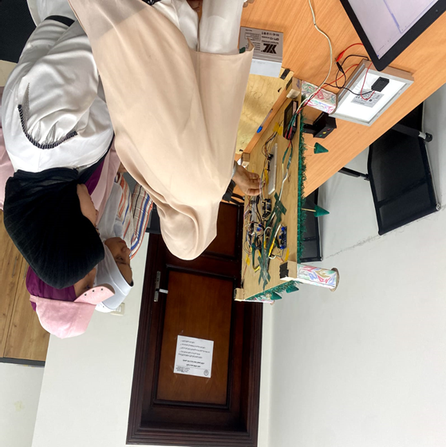
Meetings : While working on the project, we held meetings to find out the progress that was reached through the assembly at the university or through the online. Pictures during the meeting at the university:

Slide 24
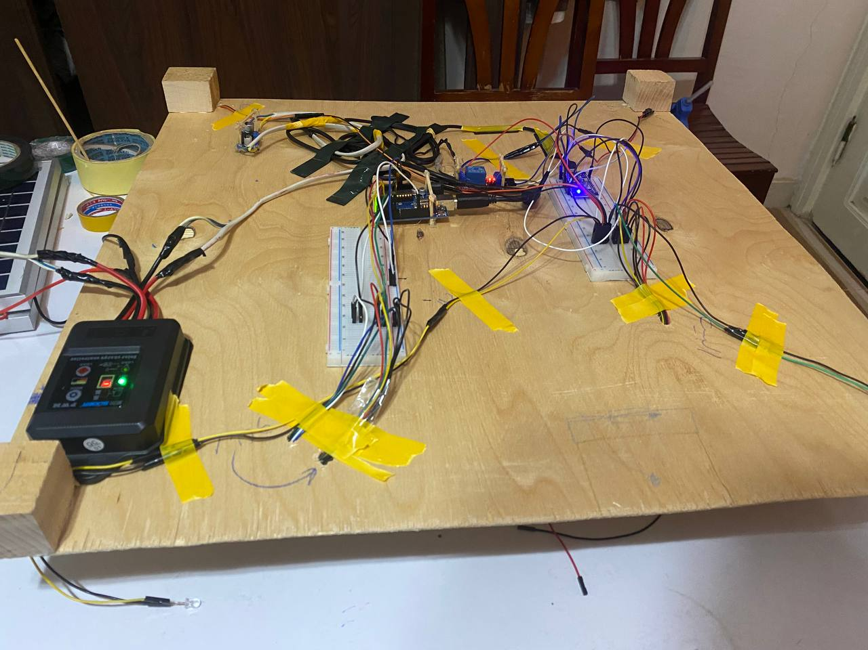
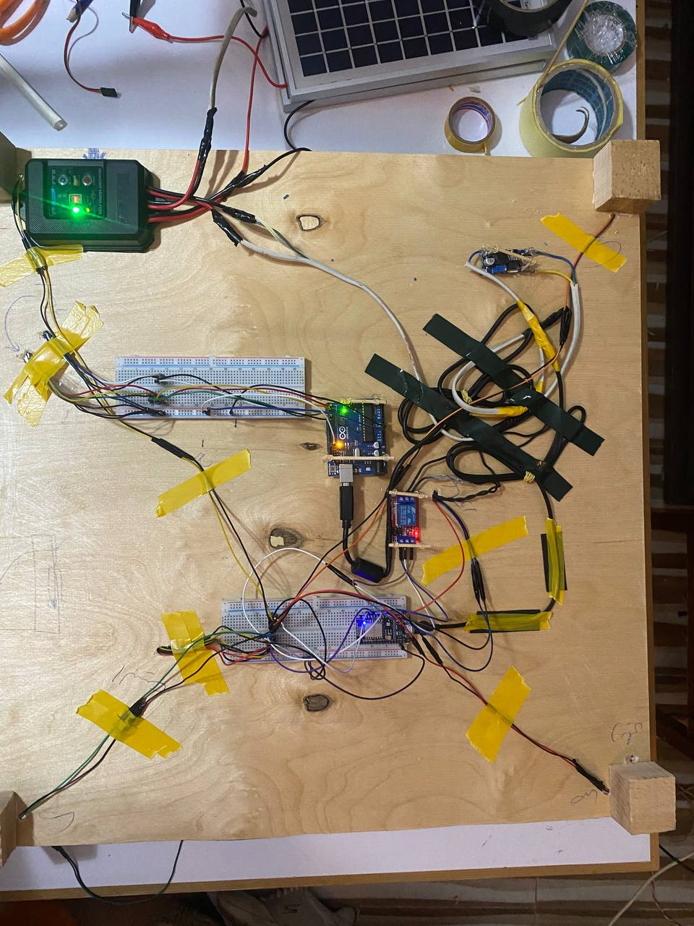
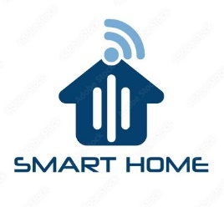
Pictures of equipment delivery to the project
Connections

Slide 25

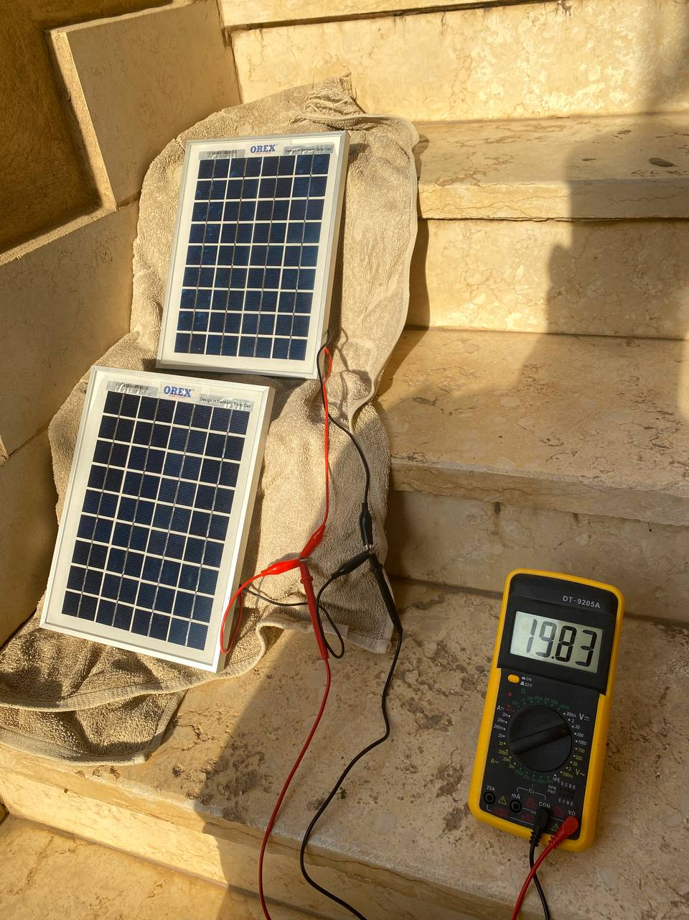
When charging solar panels from sunlight to be stored in the battery for use in times of home power outages:

Slide 26
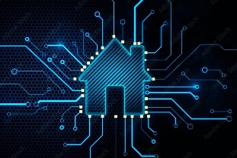

A picture of the house after work

Slide 27
Project team creative team
Mohmed Abdelmonem.
Abdallah Mohamed .
Abdullah Samy .
Hassan Khaled.
Ali Mohamed .
Mazen Maher.
Fatma Saleh.
Ayat Mahmoud.
Hager Yasser.
Nourhan Hosni.

Slide 28
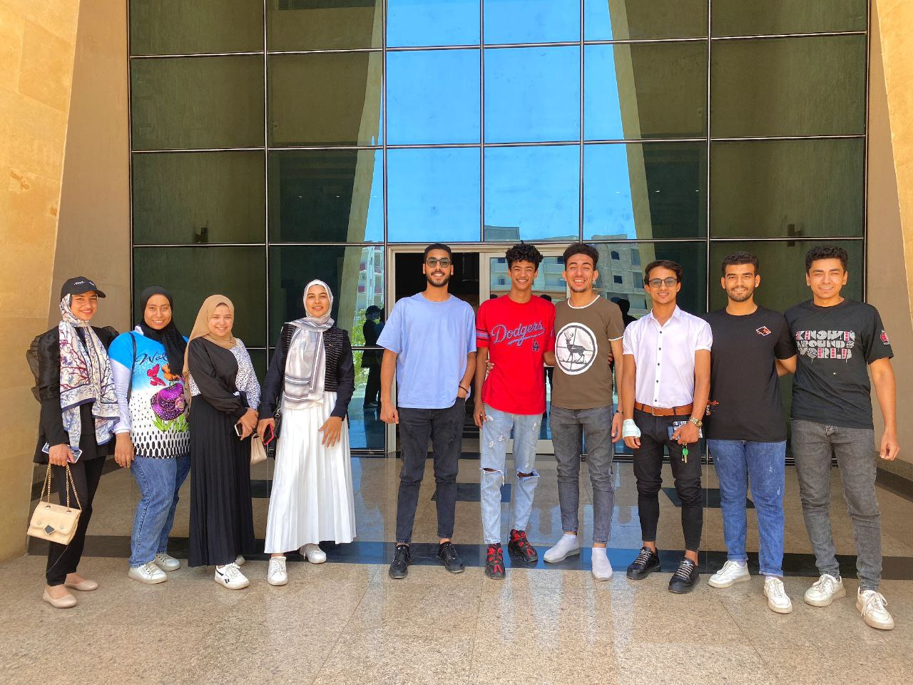
A photo of the team involved in the project

